Slide 1
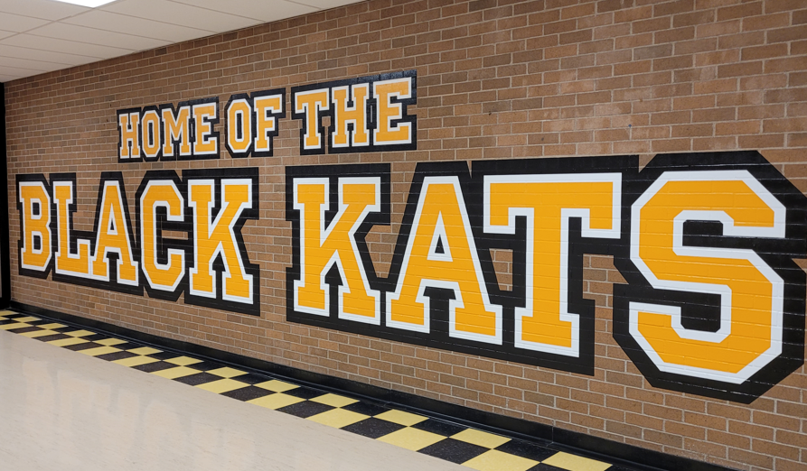
Get Involved/Find Your Crew:
FHS Clubs

Slide 2
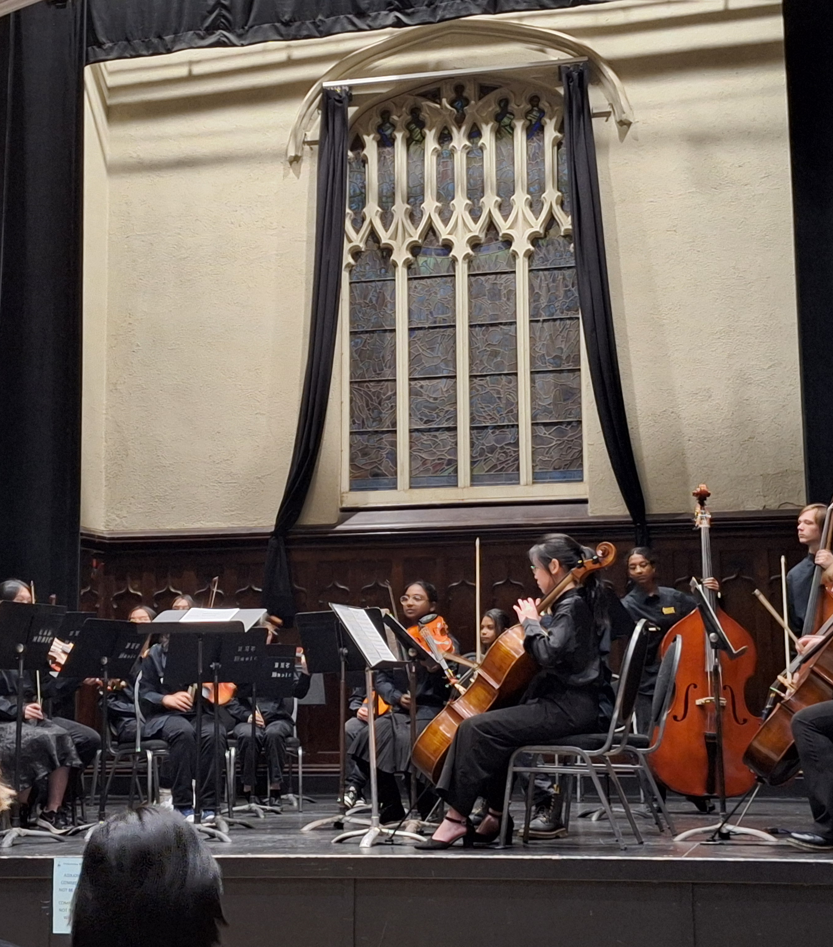
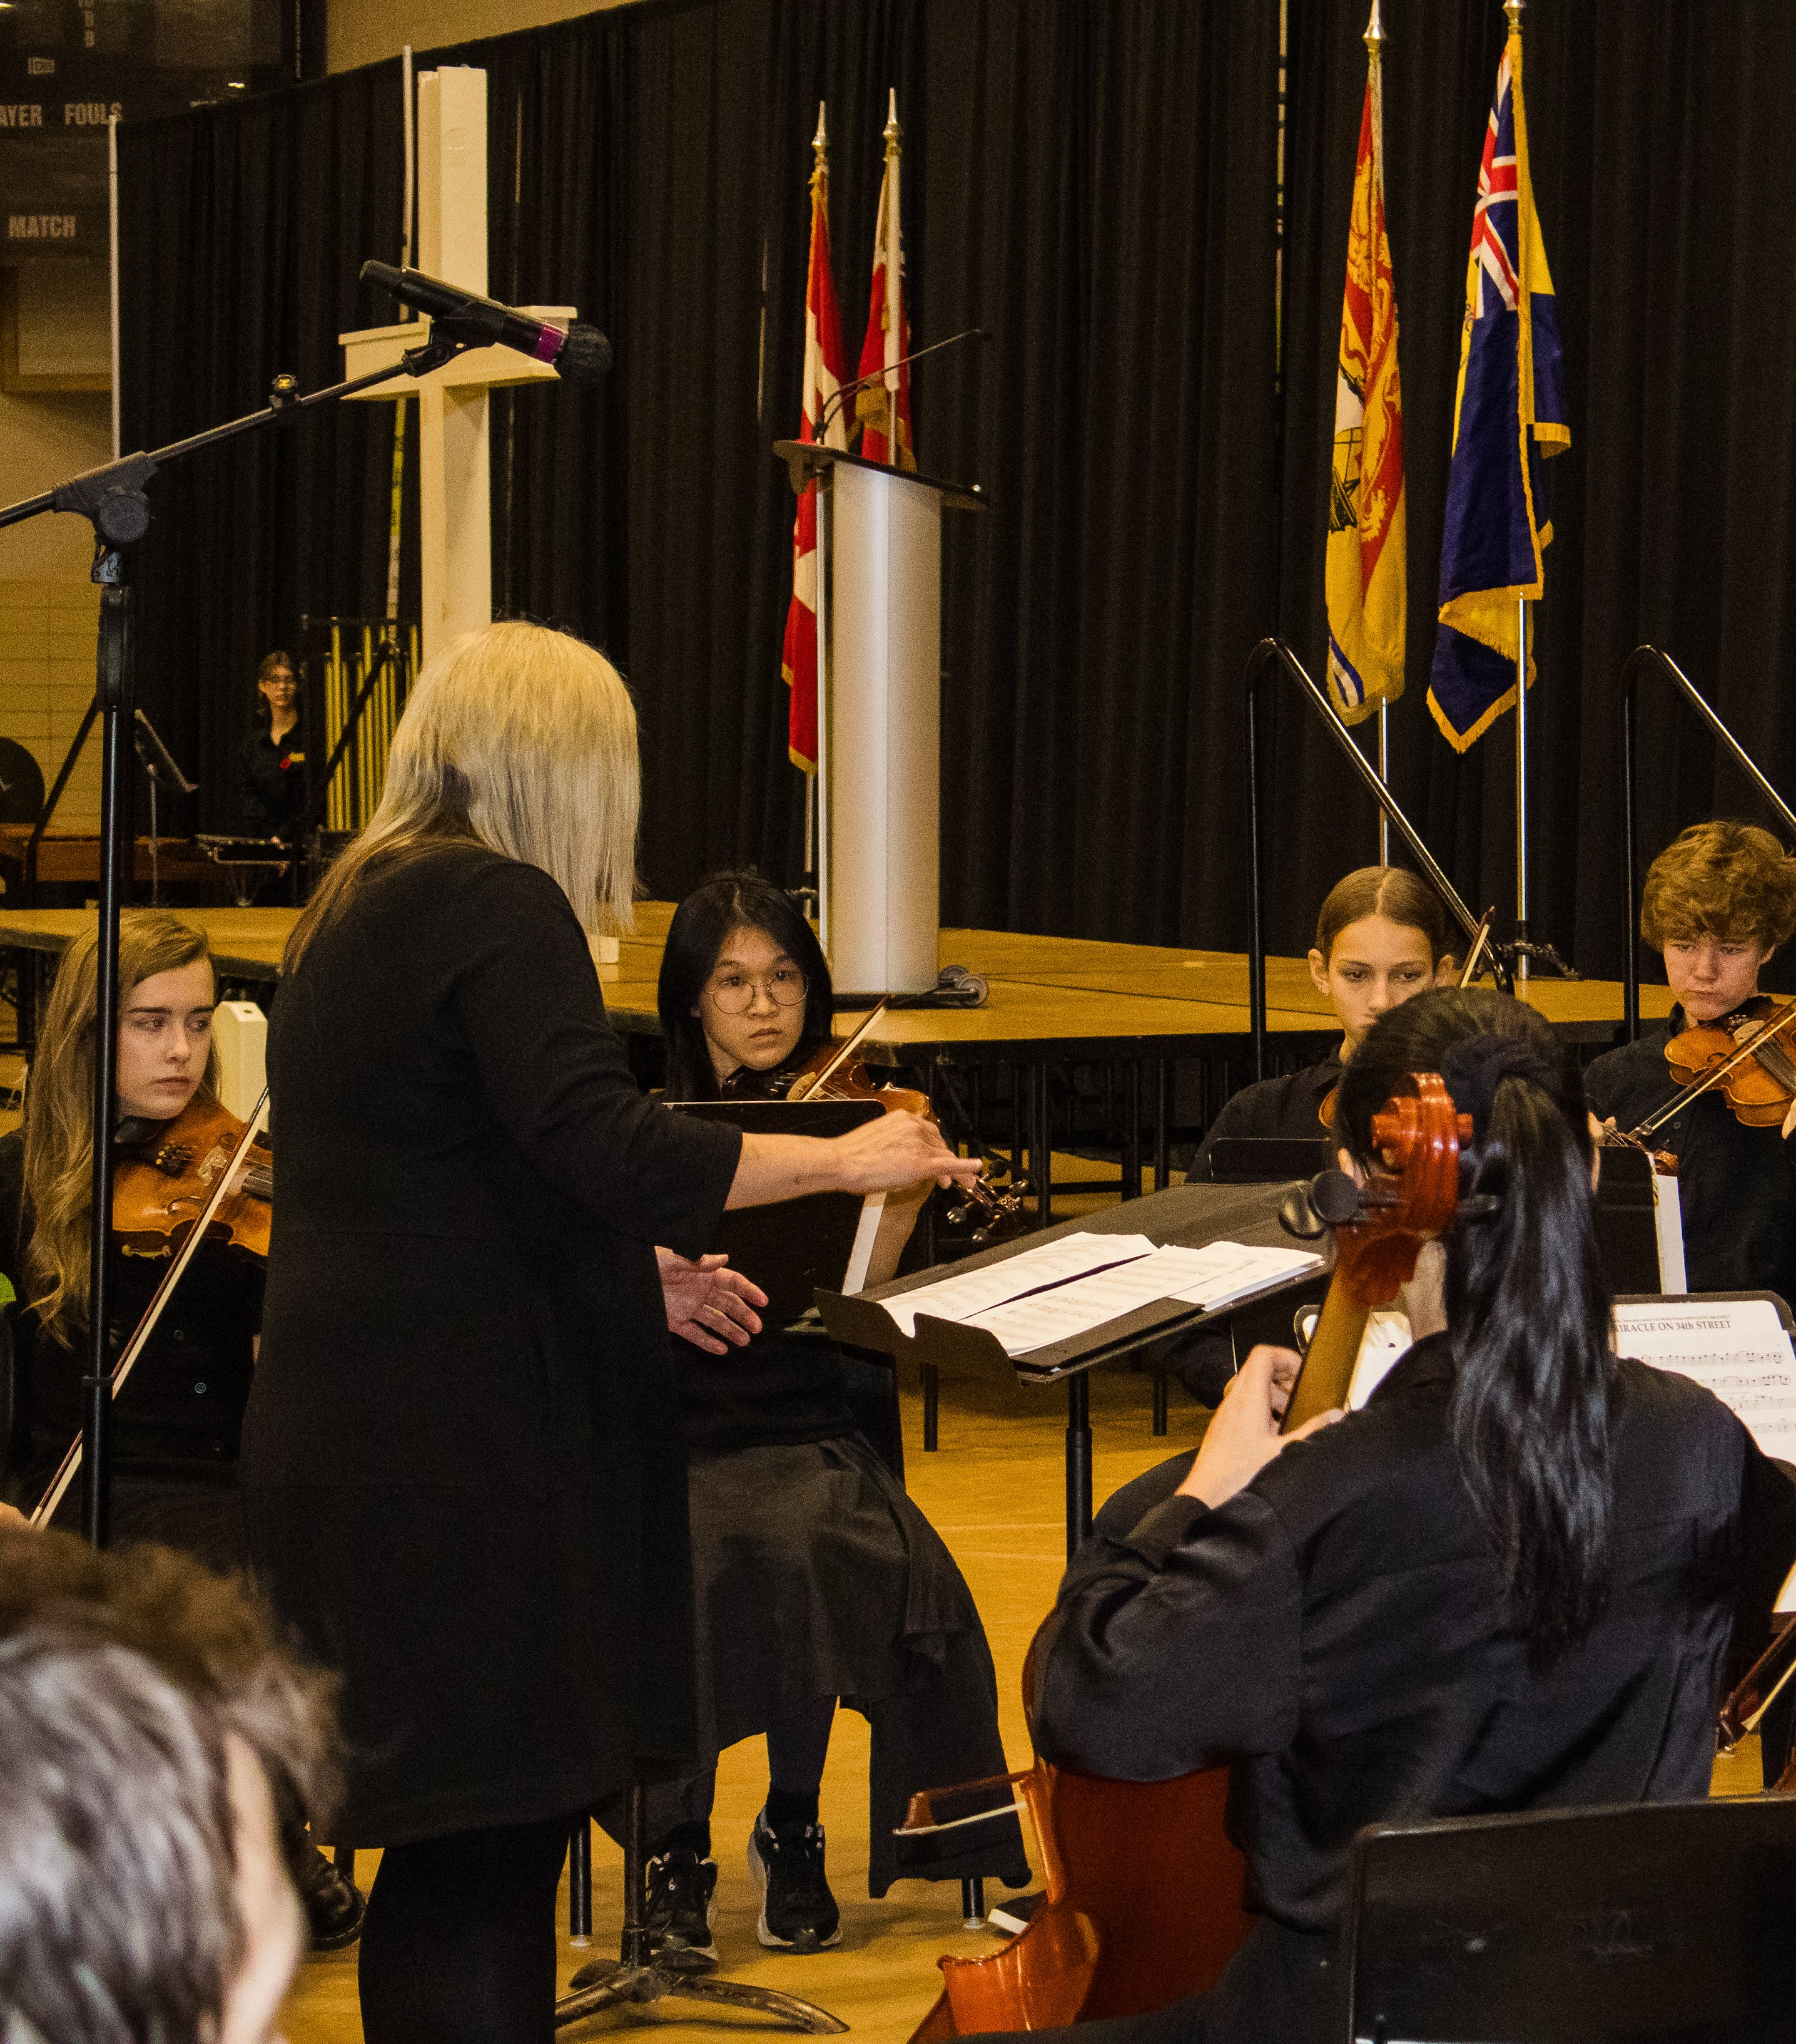
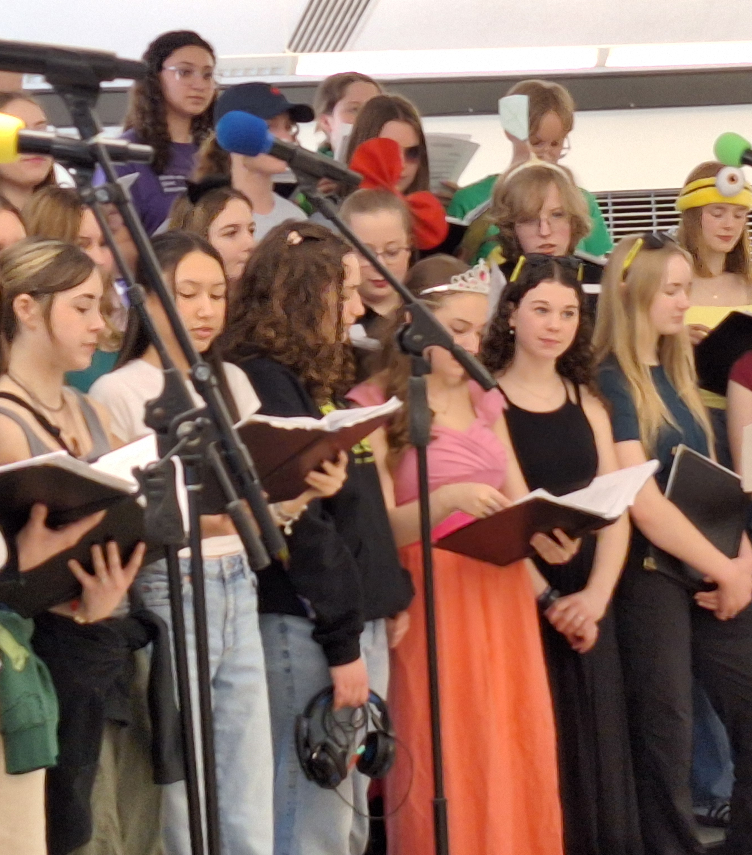
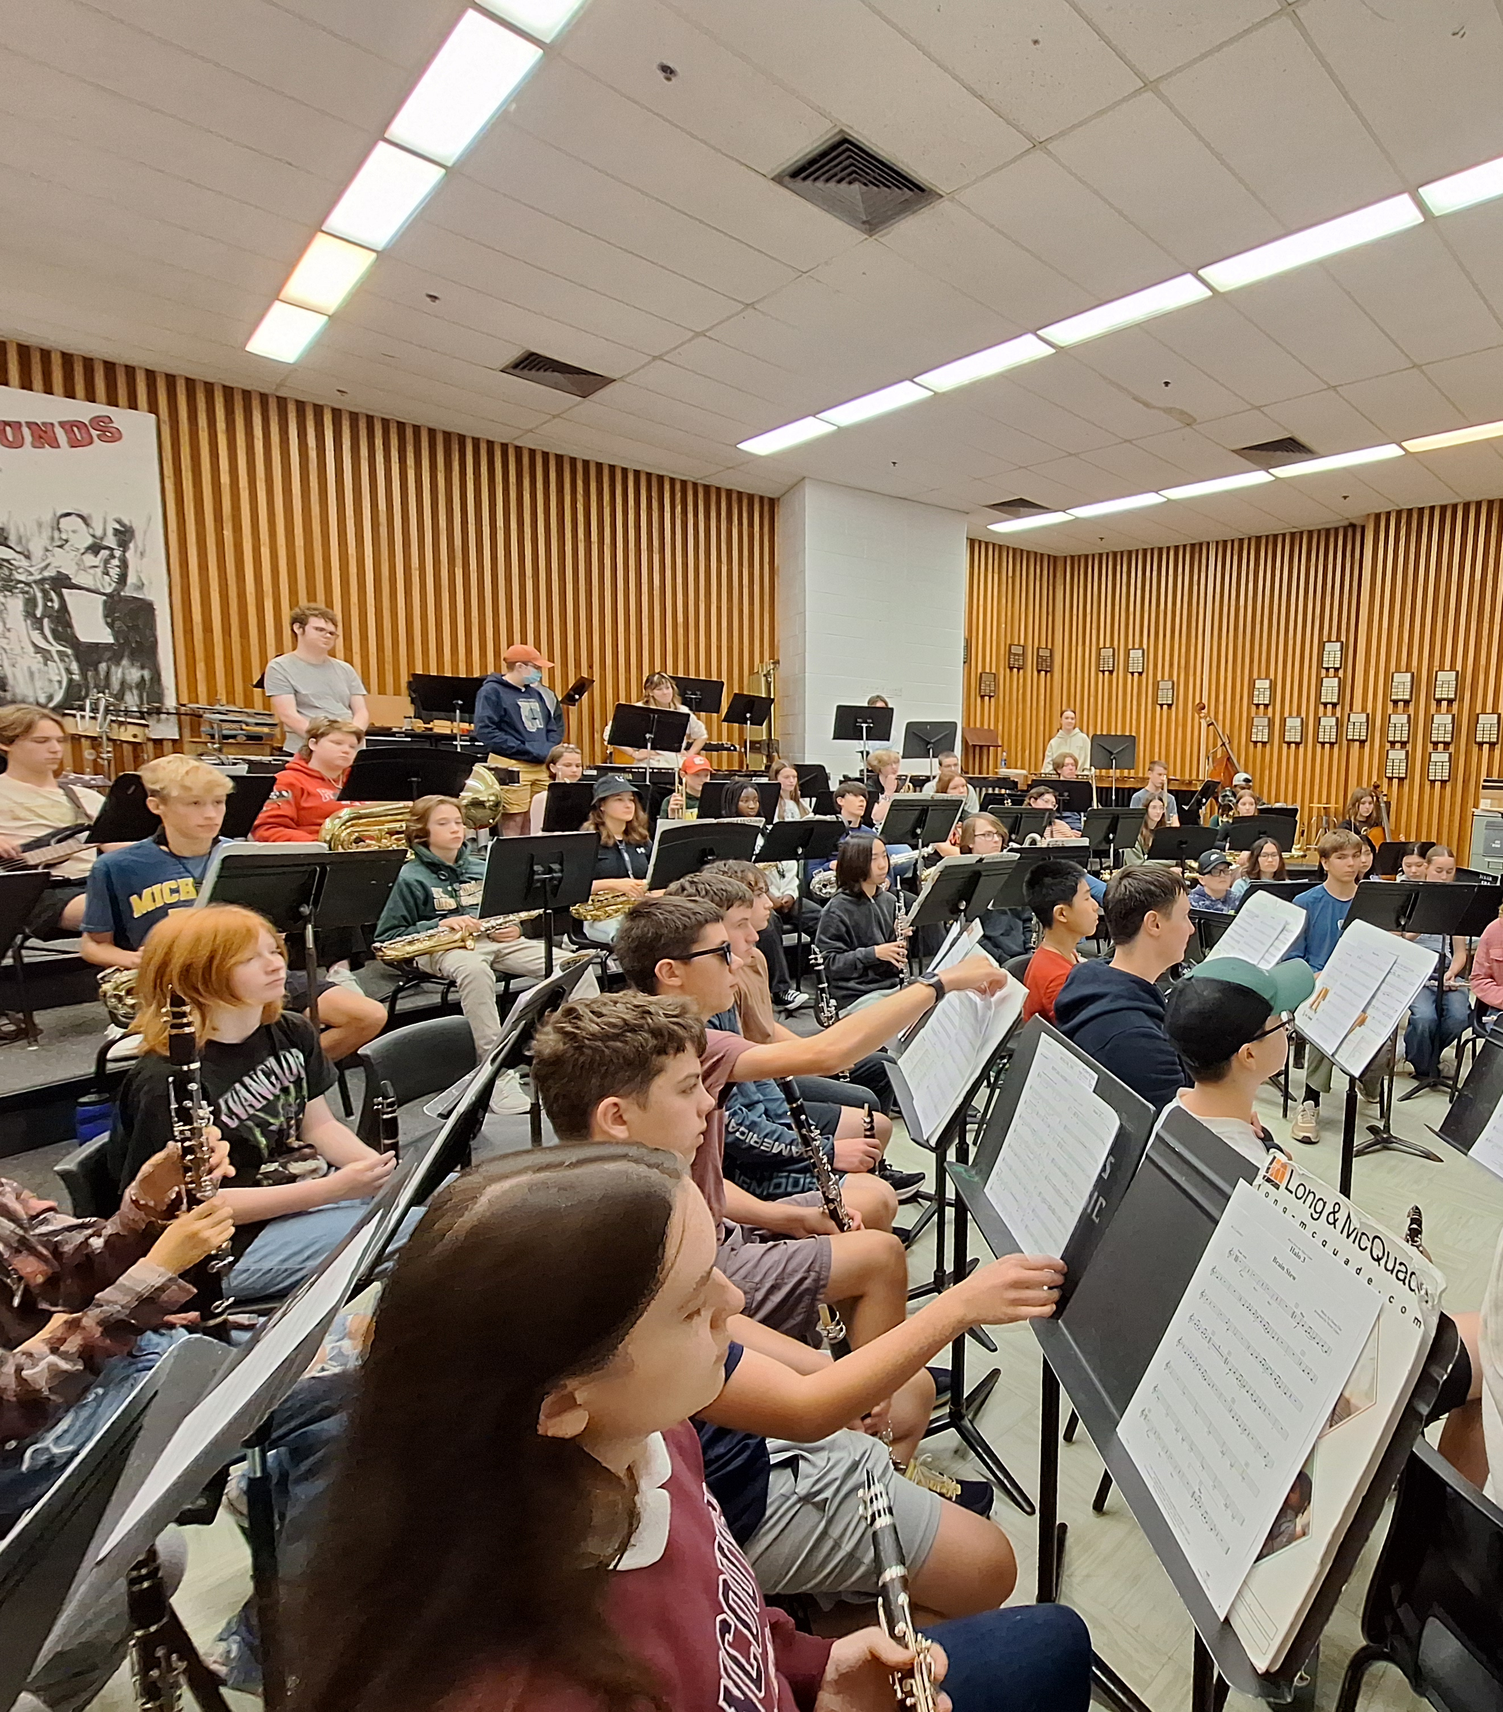
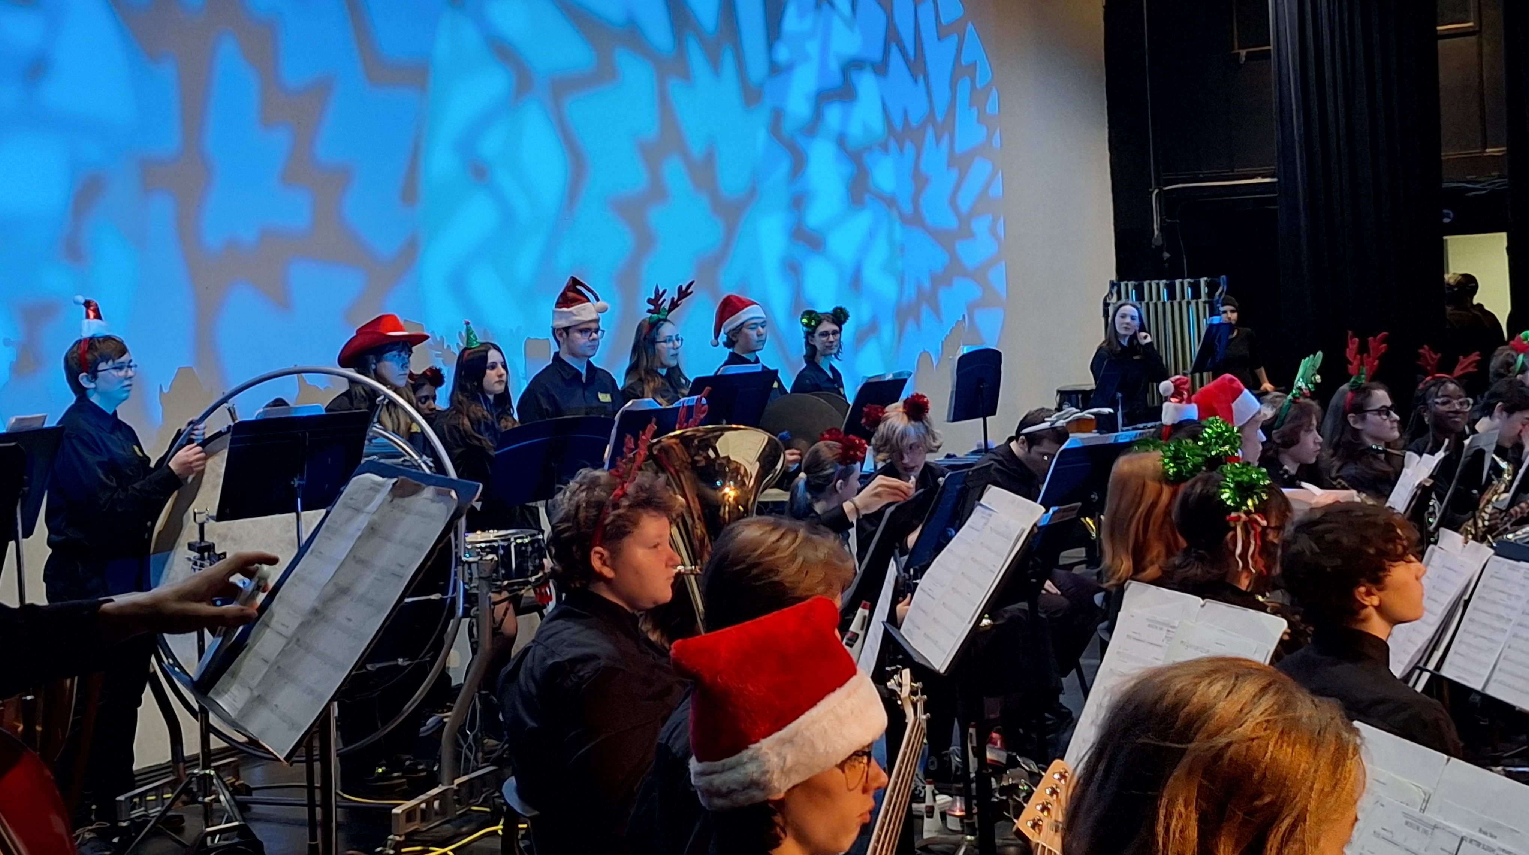
FHS Music
Jazz Ensemble
Glee Choir
String Ensemble
Concert Band

Slide 3
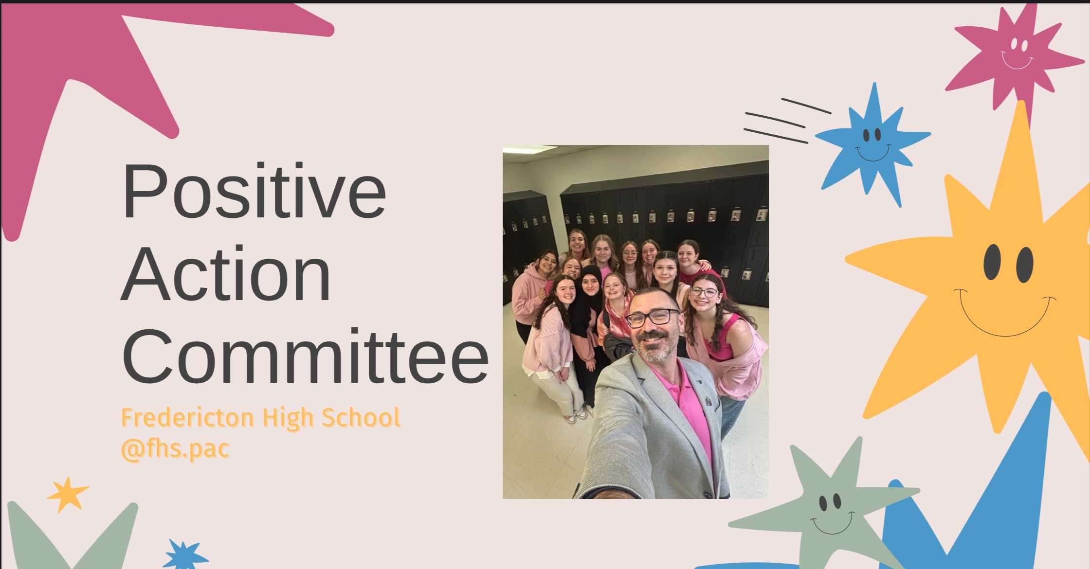

Slide 4
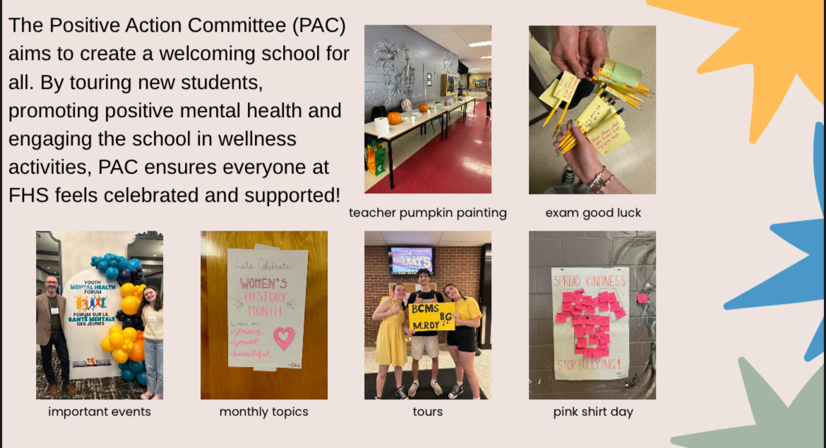

Slide 5
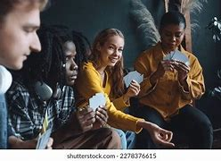

🎉 Neurodiversity Club @ FHS 🎉
Open to all neurodiverse students — diagnosed or not!
A safe, supportive space to be yourself
We meet once a week at lunch
Relax, recharge, and connect with others
✨ “Different minds. Shared community.” ✨

Slide 6
💡 What can you expect?
🎲 Games & fun activities
🎵 Music and chill hangouts
🎬 Movie lunches (sometimes!)
🗣️ Great conversations
🧠 A place where you can just be YOU
💬 Come check us out when you get to FHS — we’d love to meet you!

Slide 7




Slide 8
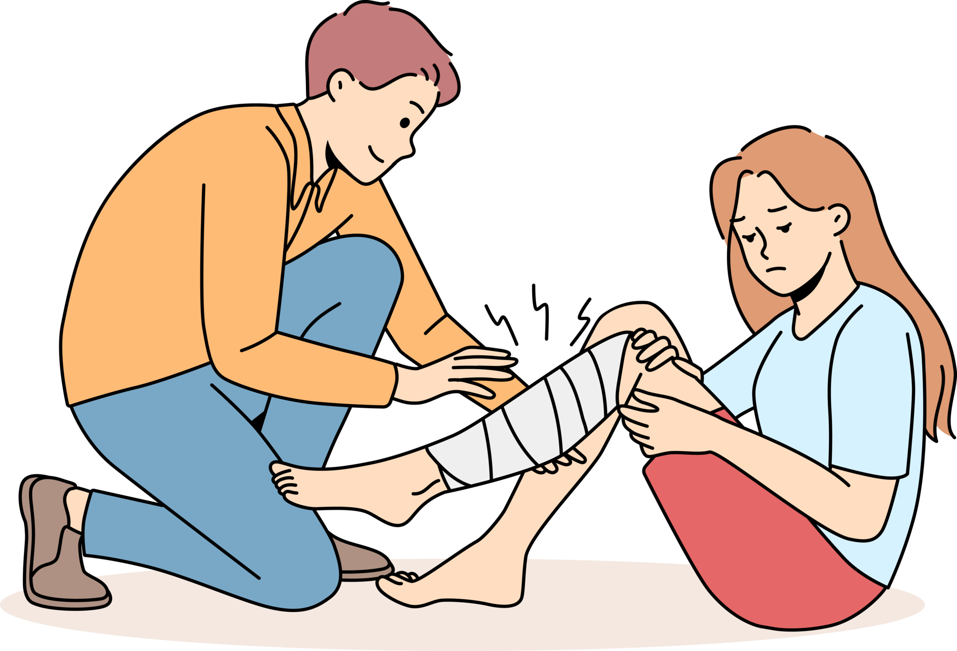

What is ERT?
It is a trained group of students responsible for responding to medical emergencies around the school.
What is the purpose of ERT?
Give first aid or basic medical support and contact emergency services if needed.
Who Join ERT?
ALL students are welcome and encouraged to join!
Emergency Response Team (ERT)
Why is ERT Important?
Helps keep people safe and ensures a faster response time during an emergency.

Slide 9

FHS Chess Club
By: Iris Chen

Slide 10
Information you should about it
Joining the Chess Club is a great way to sharpen your mind while having fun! Whether you're a beginner or an advance player, the club offers a welcoming space to learn new strategies, challenge yourself, and make new friends.
Location: Tuesday in Mr. Leroux's room (C122) and Thursday in Ms. Jarvis's room (C12)
We meet every twice during the week and is totally causal!
Come check it out! There will be in house tournaments, activities and much more.

Slide 11

Kats’ Kitchen
Grab ‘n Go breakfast during the 20 minutes before classes start
Grab ‘n Go lunch during the first 20 minutes of lunch hour
Healthy and delicious food
Available for any student, every day of the week
Located in the main hallway – easy to find!
(and it’s free!)

Slide 12
Kats’ Kitchen
Want to volunteer? Join us at our first meeting in the fall!
Serve breakfast or lunch once or twice a month – not a big commitment!
Meetings every other week
Volunteer events throughout the year – fundraising, community events
Develop leadership skills and help out in the
community!

Slide 13

@ lunch in C137
New members always welcome!

Slide 14
Reach for the Top is a Canadian academic quiz competition for high school students. Teams of four compete head-to-head in fast-paced matches, answering a wide variety of questions from subjects like:
History
Geography
Science
Literature
Math
Pop Culture
Current Events
General Knowledge
There are weekly practices, monthly tournaments(~5 – 6), provincial finals, and a national competition.
Monthly tournaments happen around the province with different schools hosting.
The season runs from October to April.

Slide 15

🎯 How It Works
Players buzz in to answer questions first.
Some rounds have team questions, where players can confer.
Points are earned for correct answers and lost for incorrect ones (in some formats).
Matches are usually 30–40 minutes long.
Questions
🔬 ScienceQ: What gas do plants absorb from the atmosphere during photosynthesis?A: Carbon dioxide
🌍 GeographyQ: What is the capital city of Norway?A: Oslo
📖 LiteratureQ: Who wrote To Kill a Mockingbird?A: Harper Lee
📆 HistoryQ: In what year did World War II end?A: 1945
🧮 MathQ: What is the value of 8 squared?A: 64
🎬 Pop CultureQ: Which Marvel superhero is known as the “friendly neighborhood” Spider-Man?A: Spider-Man

Slide 16
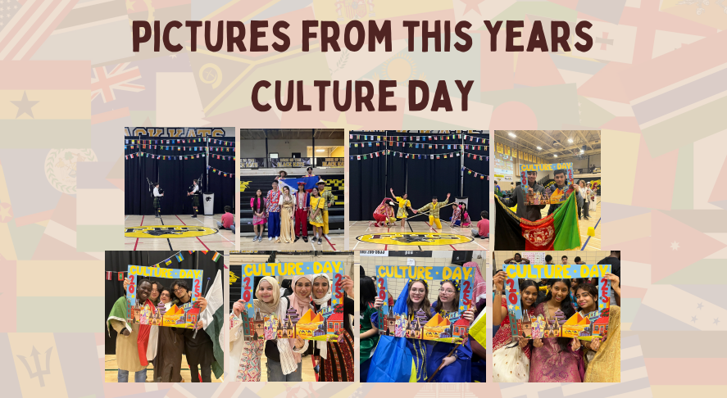

Slide 17
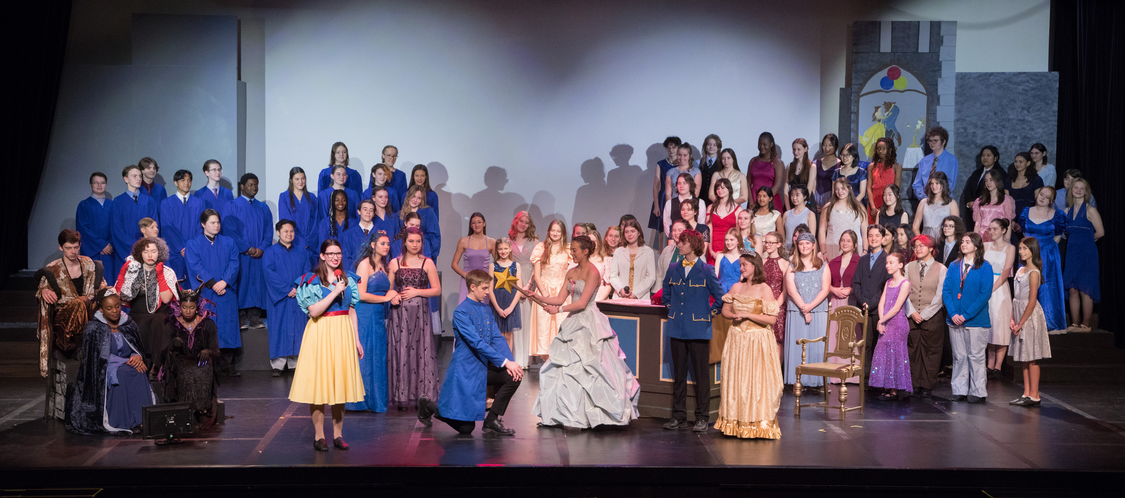
FHS PRODUCTION
2023 Production of
Disney's Descendants
NOVEMBER 2025
SHOW: TBD

Slide 18
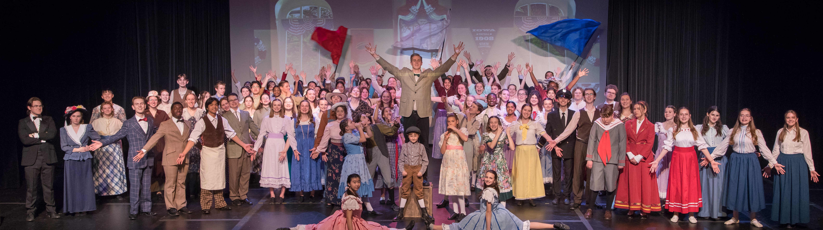
JOIN US FOR OUR 2025 MUSICAL PRODUCTION
Anyone can join the chorus. More detail to come in September!
2024 Production of Meredith Wilson's The Music Man
Ms. Senechal, Ms. Vermeersch and Mme. Aube will be coming to visit your school in June and audition for our Production Homeroom.
Please let your theatre director, or drama teacher, know if you are interested in auditioning.

Slide 19


Slide 20
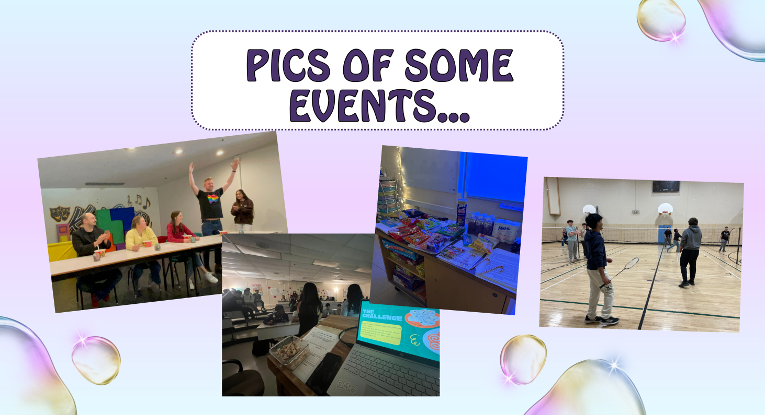

Slide 21
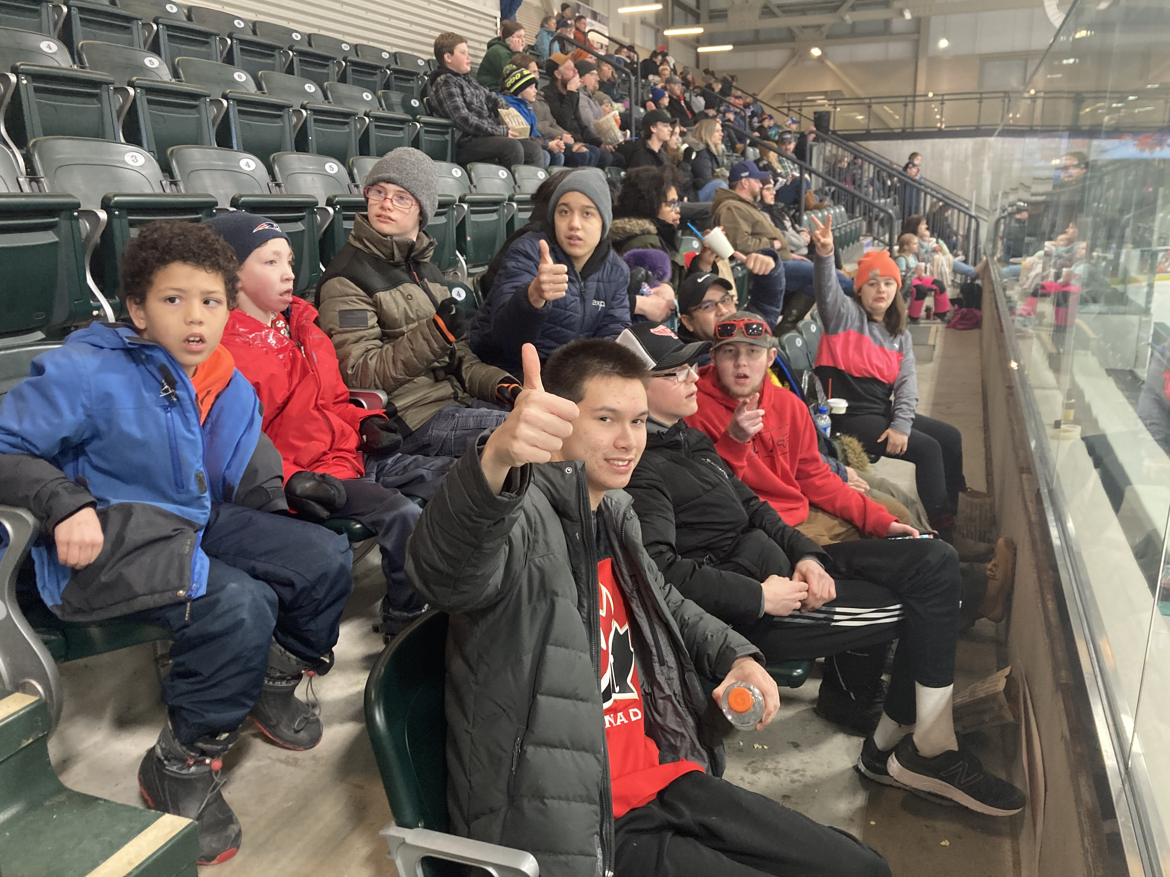

FHS Best Buddies
FHS Best Buddies builds friendships between people with and without intellectual and developmental disabilities.
Teacher Facilitators: Mrs. McCarthy & Mrs. Mahar

Slide 22
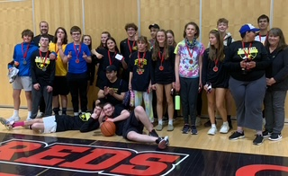
Unified Basketball
Unified Basketball is dedicated to promoting social inclusion through shared sports training and competition experiences. It joins people with and without intellectual disabilities on the same team. It was inspired by a simple principle: training together and playing together is a quick path to friendship and understanding.
Teacher Facilitators: Galen Smith, Steve Chan & Donna Morton

Slide 23
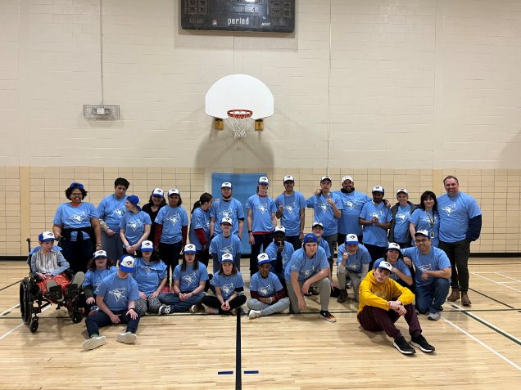
Challenger Baseball
Challenger Baseball – Our students play Baseball during the lunch and each student is given the opportunity to play in the field and bat. Students are given the chance to about teamwork and cheering each other on!
Teacher Facilitators: Steve Chan, Donna Morton, several Resource members and our EAs!

Slide 24





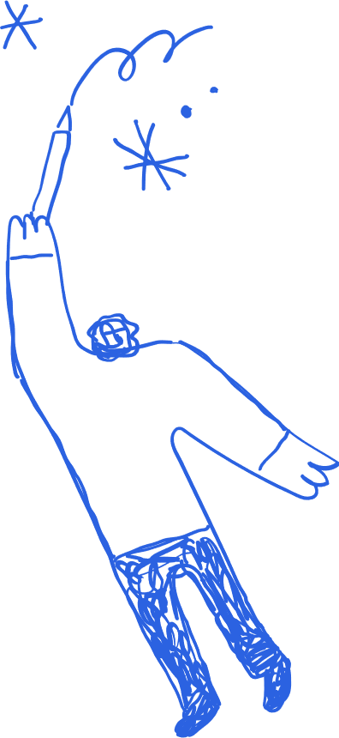

FHS Craft Club
In the middle of busy school weeks, it's easy to forget to make time for art. Our club gives you the space to slow down, try new mediums, and actually make something new. No experience is needed, just bring your creativity!
WHT
BRD
Welcome!

Slide 25
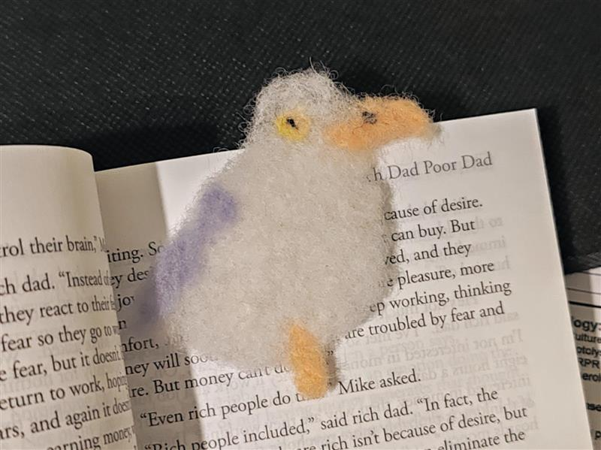

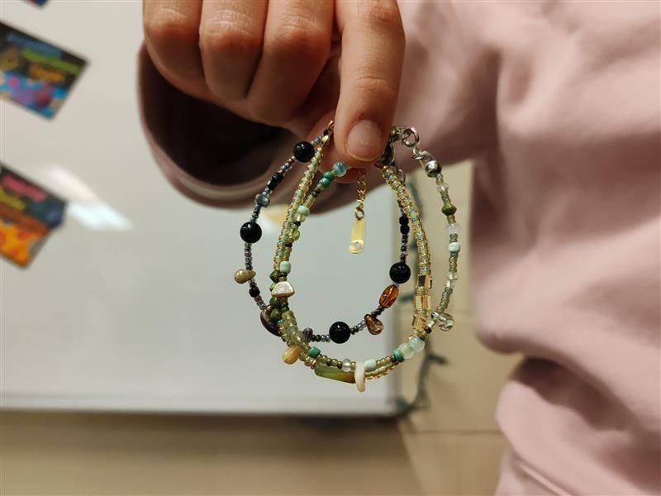
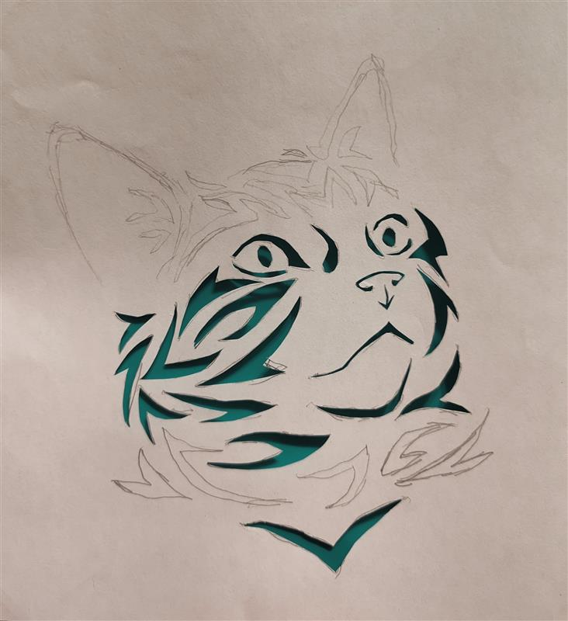
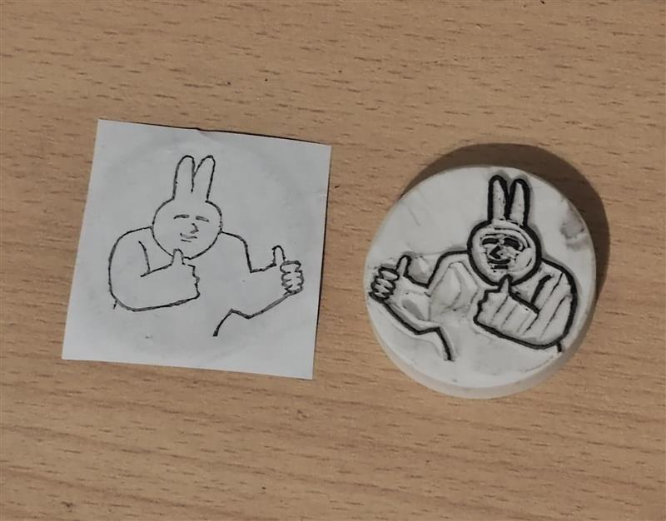
Each year, this club try to provide materials for as many different mediums as possible. The 2024-25 year, we experimented with clay, wool felting, shrinking plastics, bracelet making, stamp carving, paper cutting, and many more!

Slide 26
More Clubs …….
Model United Nations
Investment Club
Robotics
Magic the Gathering
Writers Club
Stray Kats Auto Club (Grade 9-12 Co-Ed drag racing team)
The Rhythm Game Club
Nail Art & Nail Painting

Slide 27
……And More…..
Dungeons & Dragons
Dreamcatcher Club
Dance Club
Community in Christ
Outdoors Club
SCIENCE CLUB
GAME CLUB
TECHNOVATION GIRLS CLUB

Slide 28
….Even More…….
Abacus Club (Math Club)
Revolution Racers (Females+ car club/Drag race team)
Safe Space
Coding Club
Languages Club
Pottery Club
Esports (Gaming)
FHS Arabian Roots

Slide 29
….And Finally……
Art Club
Fencing Club
Drama/Improv Club
Fashion Club
French Grammar Club
POSSIBILITY TO CREATE YOUR OWN!

Slide 30
When? Where? How Will I Know?
Near the end of September, there will be a Club Extravaganza (you will hear about it on the announcements) during lunch time. From there, the school creates a listing of the clubs offered that year, what day of the week, and what room number it is hosted in.
This will be posted to the FHS website, but if you would like a printed copy, come down to the School Counselling Department and pick one up!
Go Club Shopping until you find your crew and your place ☺

