Slide 1
Fredericton High School
Grad Information Session 2025

Slide 2
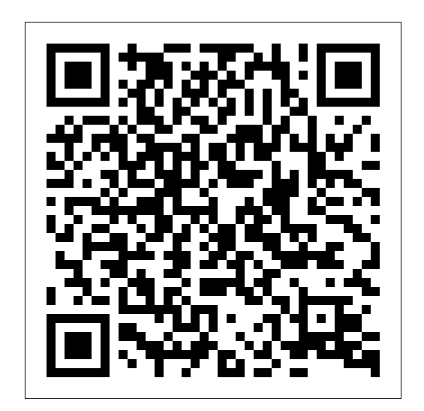
Grade 12 Exit Survey

Slide 3
Marks
Report Card Pick Up – Date TBD
HOMEROOM ADVISORY TEACHER
Please reach talk to your teachers. They are here to help you. Don’t wait as the demands will continue to pile up. We here to help.

Slide 4
Black and Yellow Awards Assembly – First Week of June
Valedictorian Speech
Black Kat Scholar
In-House Scholarships
Athletic Awards
Grad Group Photo
June 8th, Period 3
TMT

Slide 5
Honors – Mr. Garnett
Awarded to those graduates with 90+% average.
Based on 8 compulsory courses and 10 best grade 11 /12 electives.
You must apply! Due May 16th, no late applications accepted.
Marks will be verified once final.
Recipients will be given a certificate and honors cord at graduation ceremony

Slide 6
In House Scholarships – Mrs. Maxwell
Still lots of time to apply – scholarships available for all types of students and post-secondary pathways!
NBCC Bound? Be sure to complete their entrance scholarship!
In House Scholarships – usually posted April/May. Be watching for more info!

Slide 7
Prom – Ms. Hiltz June 16th

Slide 8
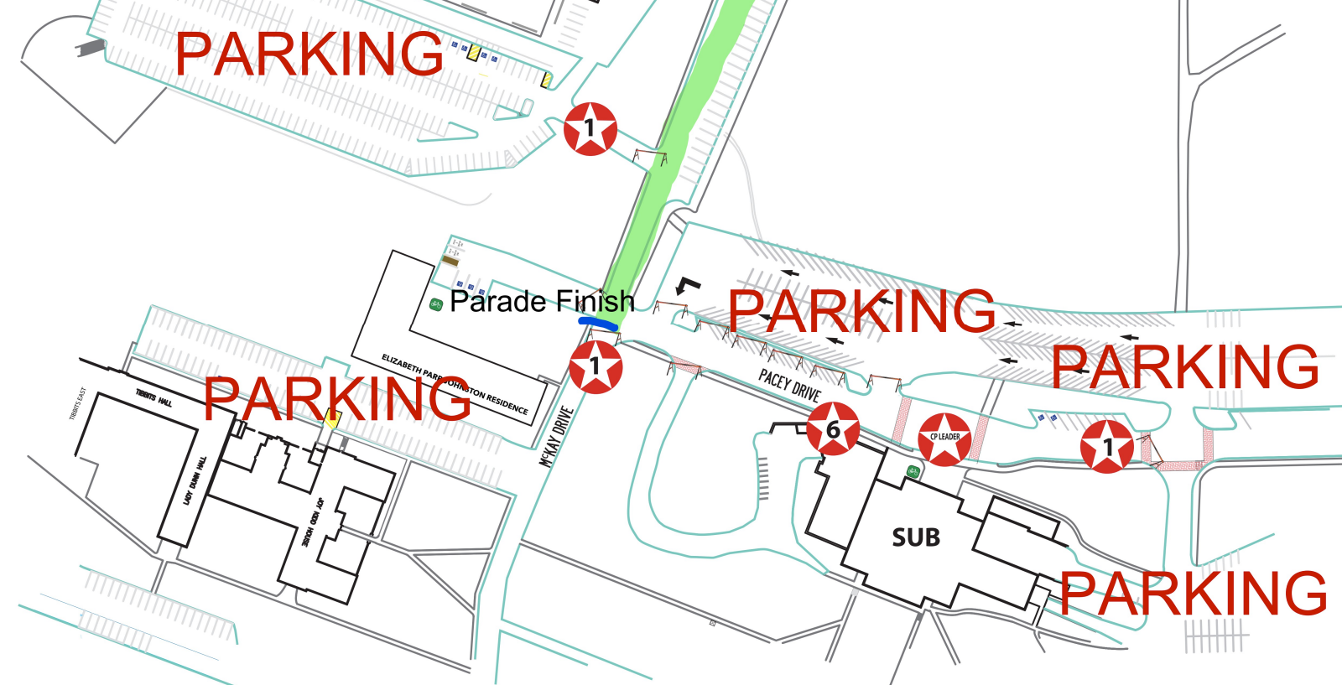

Slide 10
Safe Grad – Ms. Chisholm June 16th 11:00 p.m.

Slide 11
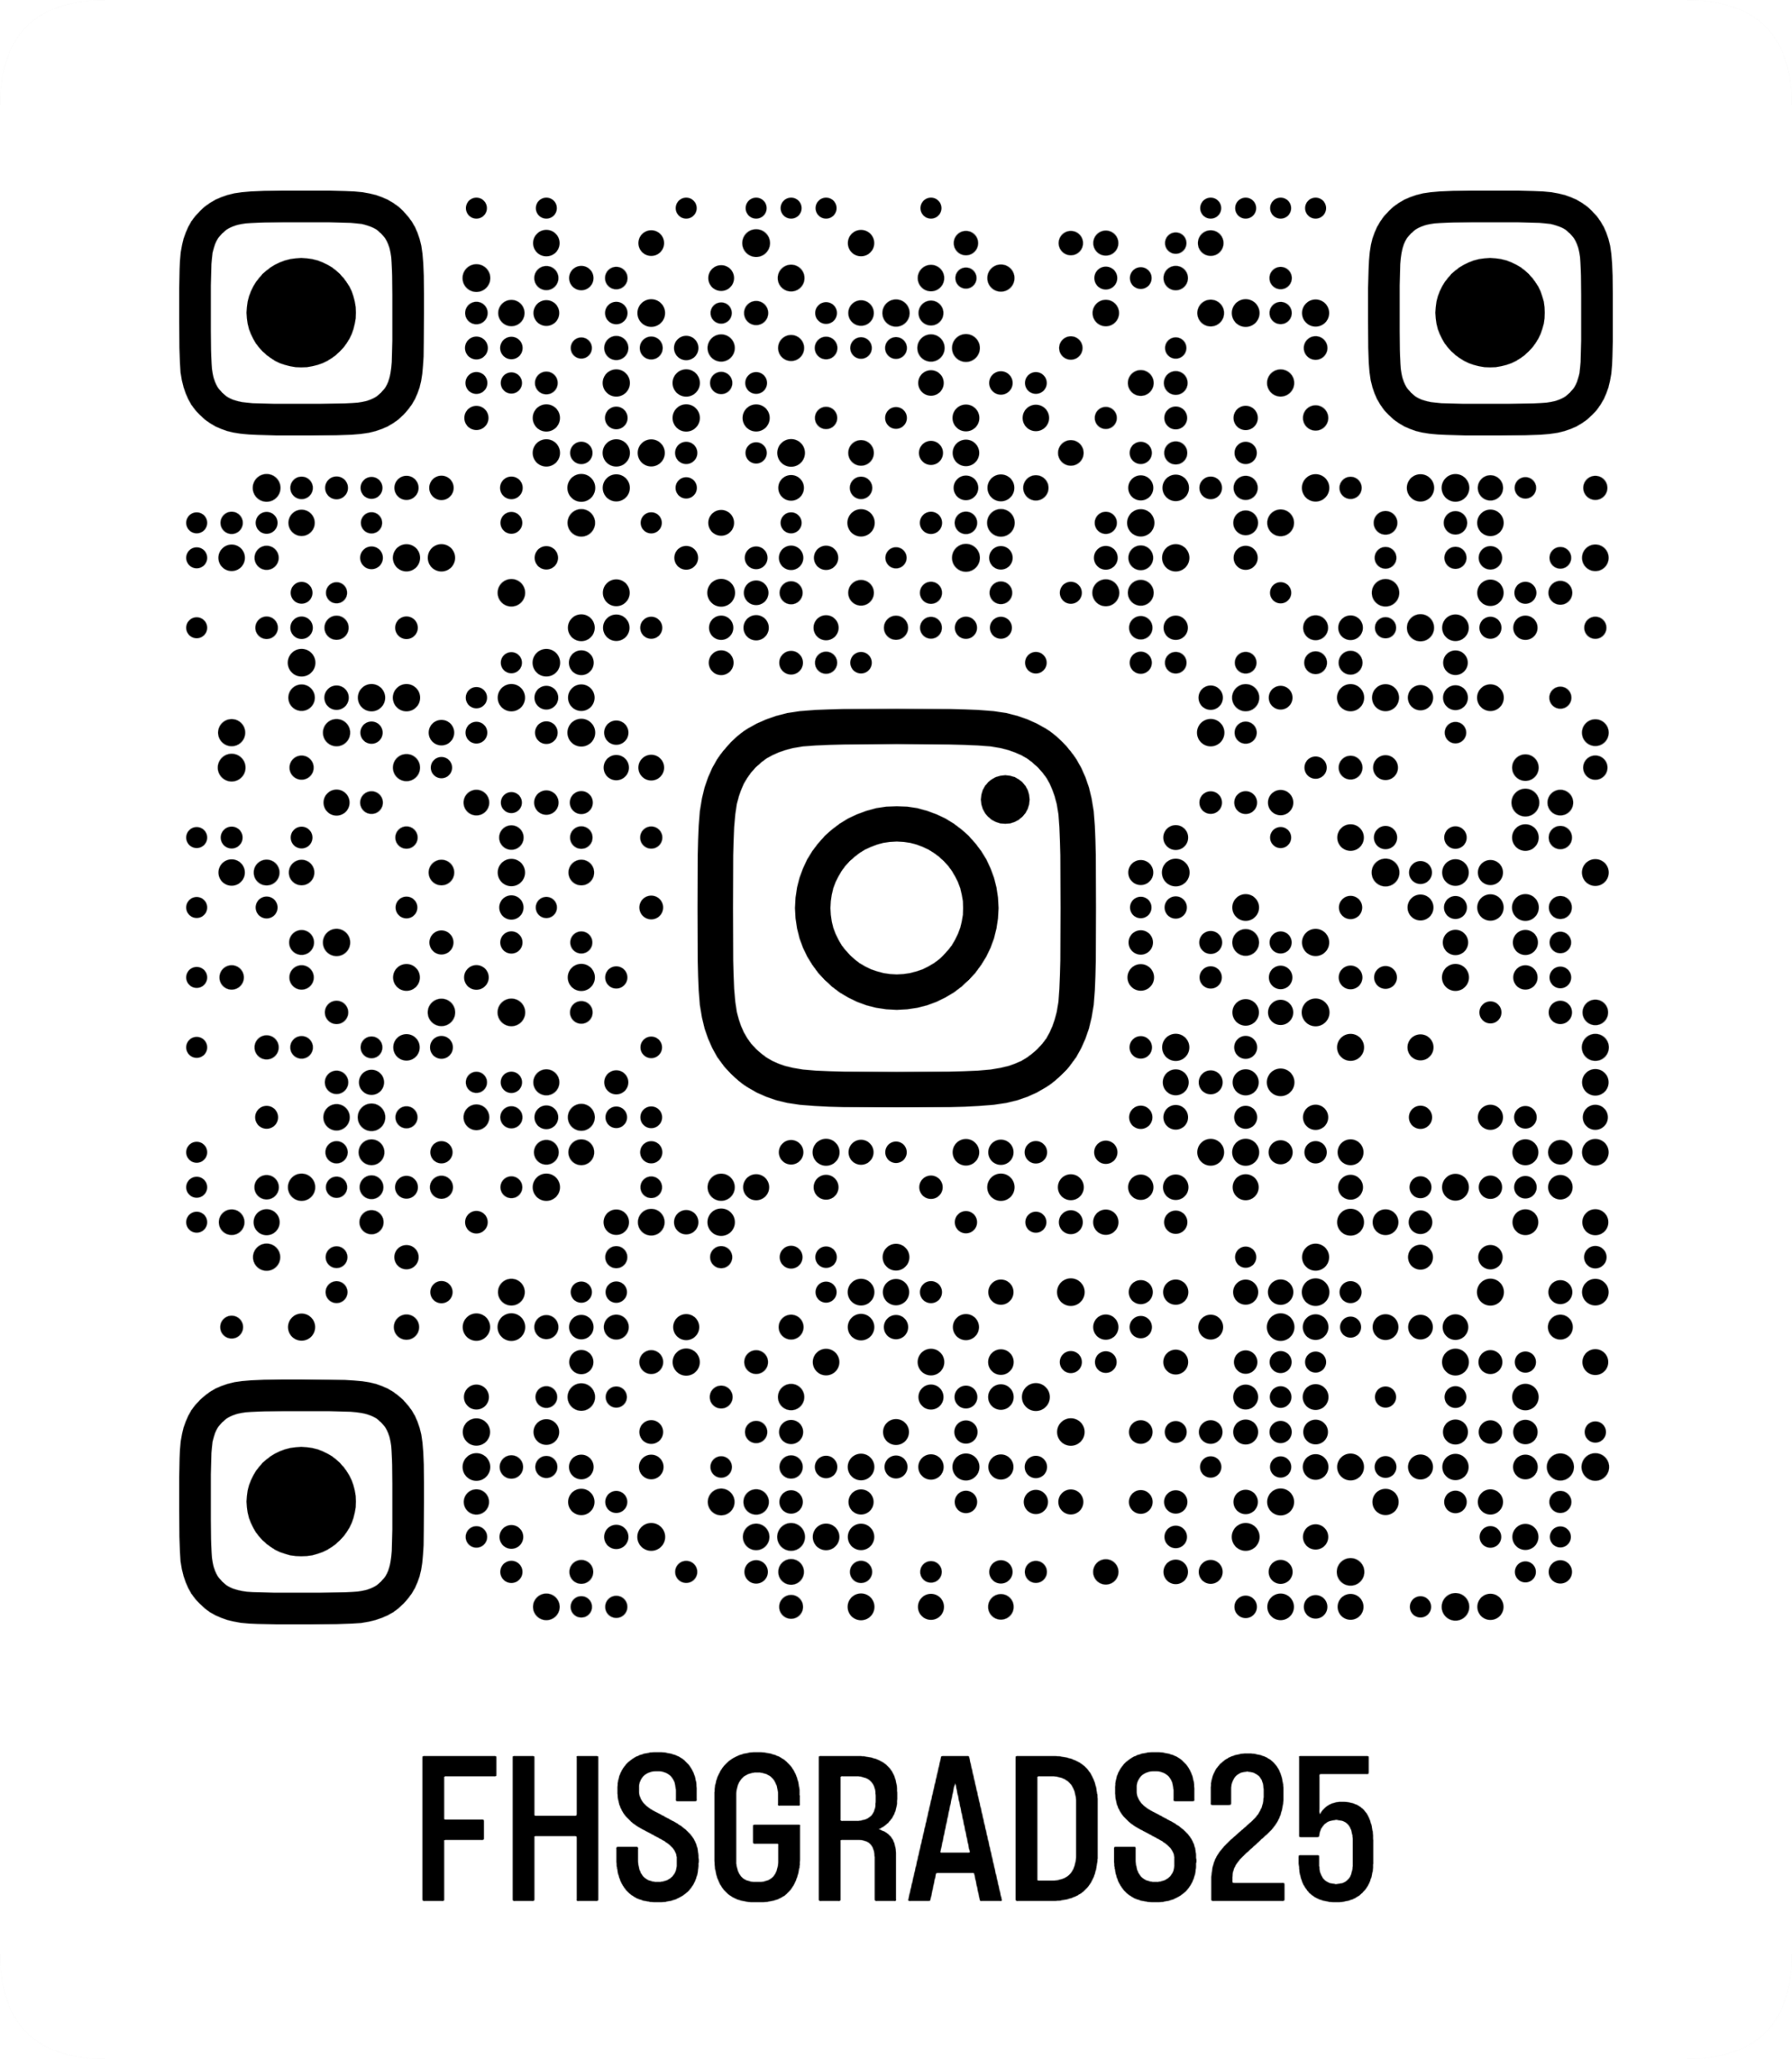
FOLLOW OUR INSTAGRAM FOR UPCOMING NEWS
@fhsgrads2025

Slide 12
UPCOMING EVENTS
June 19
Roaries - March 20
FHS got Talent
Auditions -April 15+16
Show - May 21
Spirit theme weeks April and June
Bingo Night – April
Prom + Safe Grad - June 16
Graduation – June 19

Slide 13
WHAT IS SAFE GRAD?
Bouncy castle
Sports
Hypnotist
Escape room
Tie dye
Lazer tag
Games
Painting
Karaoke
More
Prizes - Almost $10 000 in prizes (each prize is about $500)
Luke Bryan Tickets
PS5
TV
STU and UNB Tuition vouchers
Gift cards
Dorm package
Adventure and Beauty Baskets

Slide 14
Graduation – Mrs. Pearson June 19th

Slide 15
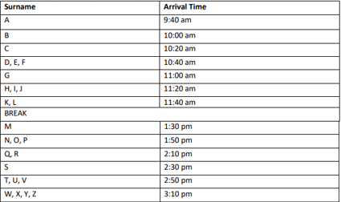

Slide 16
GOWNS (Pick Up)
Procedure for picking up gowns will be shared when the date gets closer.
Grad Fee $100.00 + online processing fees

Slide 17
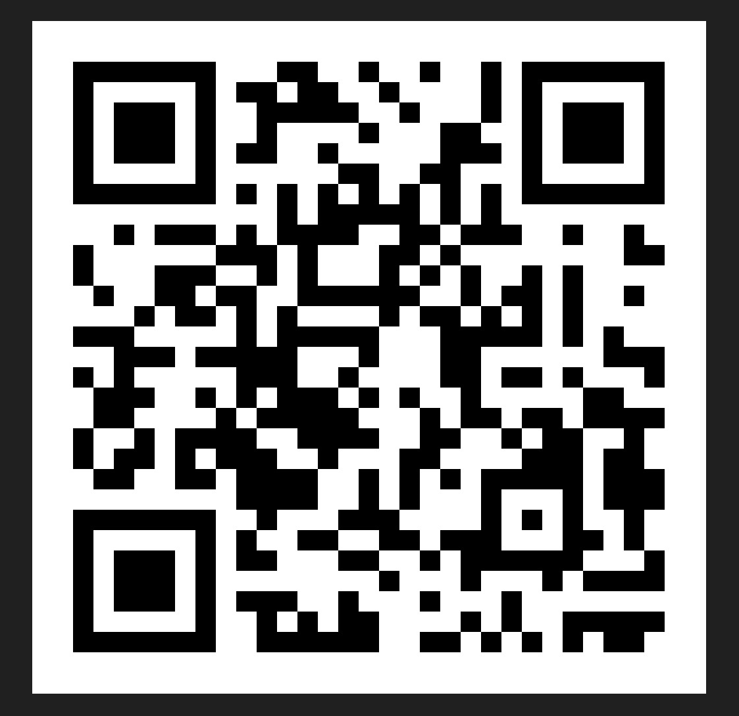
Graduation Information

