Slide 1
AP College Board Courses Fredericton High

Slide 2
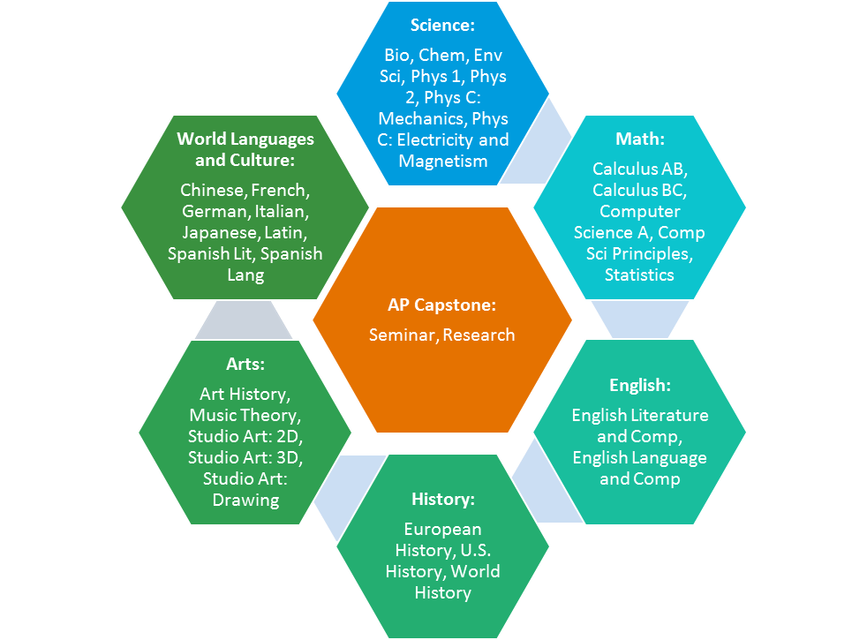
About AP®
The Advanced Placement (AP) Program enables students to pursue university-level studies while still in secondary school.
Each AP course is modeled upon a comparable university course.
AP courses conclude with a university-level assessment developed and scored by university faculty as well as experienced AP teachers.
AP Exams enable students to demonstrate their mastery of university-level course work.
Universities in more than 60 countries recognize AP in admissions.
Most four-year colleges and universities in the U.S. and Canada also grant credit or placement on the basis of successful AP Exam scores.
Research consistently shows that students who receive a score of 3 or higher on AP Exams typically experience greater academic success in university and have higher graduation rates than their non-AP peers.
38 courses, each culminating in a rigorous, standardized exam
What Is AP? – AP Students | College Board

Slide 3
How AP Courses and Exams Are Developed
University faculty and expert AP® teachers design AP courses and exams to ensure their alignment with university expectations.
Notes:
Each AP subject has its own test development committee responsible for ensuring that the exam questions are aligned to the college-level expectations outlined in the course framework.
A curriculum framework presents the scope and expectations of each course, and describes the knowledge and thinking skills students should demonstrate for success on the exam.
Data confirms that AP courses reflect current scholarship and advances in each discipline—and that AP Exams reflect and assess expectations for university-level work.

Slide 4
AP Administration & Scores
AP Scores are standardized measure of mastery.
Final score | Description
5 | Extremely well qualified
4 | Well qualified
3 | Qualified
2 | Possibly qualified
1 | No recommendation
AP® Exams are administered over two weeks in May every year.
An AP score is a weighted combination of a student’s scores on the free-response and multiple-choice sections of the exam.
Most colleges and universities in the U.S. and many in Canada grant credit and placement for scores of 3, 4, or 5; allowing students to skip the equivalent course once they get to college.
“Qualified” means that students have proven themselves capable of doing the work of an introductory-level course in a particular subject at university.
Notes:
AP Exams are administered at authorized schools and test centers. Our school will administer AP Exams to our own students as well as potentially some external AP students.
“Qualified” means that students have proven themselves capable of doing the work of an introductory-level course in a particular subject at university.
How are the AP exam scores determined?
AP scores are a combination of the scores for the free-response and multiple-choice sections of the exam. The final score is reported on a 5-point scale.
Boundaries for the five AP grades (1-5) are determined using:
Statistical data on the current exam
Grade distributions from the previous three years
Statistical equating: responses to a common set of multiple-choice questions used in the exams from year to year
Comparability studies: exam questions are administered to students in the related college course; scores and grades are compared
As a result of psychometrically sound scoring processes, rescoring is extremely rare
A 5 earned by a student in New York City is the same as a 5 earned in Shanghai or London. Comparability across years and within any given year.

Slide 5
AP Courses and Universities
https://unb.ca/admissions/transfer-credits.html
Advanced Placement (AP) | Future Students (utoronto.ca)
Advanced Placement (AP) transfer credits | Undergraduate Programs | University of Waterloo (uwaterloo.ca)
Advanced Placement Students | Desautels Faculty of Management - McGill University
Advanced Placement students - UBC | Undergraduate Programs and Admissions
Transfer/Advanced Standing Credit - AP - Undergraduate Admissions - Undergraduate Admissions - Carleton University
AP Applicants - Admissions - Dalhousie University
Advanced Placement
Newly admitted students who have completed AP courses in high school may be eligible for advanced standing (transfer credit) toward their studies.

Slide 6
AP Courses for 2024-2025
Currently being offered:
AP Biology
AP Calculus (limited space – application needed) (Pre-Calculus 120A/B with AP Calculus – 3 credits over 2 semesters)
AP Psychology
AP Physics 1 (121)/ AP Physics 2 (2nd one is not running)
AP Statistics (not running due to low numbers)
AP World History
AP English Language/Literature and Composition (not running due to low numbers)

Slide 7
AP “Exam Only” means that you study on your own. There is no teacher involvement (can offer a personal interest credit in grade 11/12) Examples:
AP Chemistry (No physical lab component)
AP Computer Science A
AP US History
AP Micro/Macro Economics
AP Environmental Science
Statistics/physics 2/ English Lit or Lang
***You must register for these through me***

Slide 8
General Information:
Please email diane.langille@nbed.nb.ca if you have any other questions.
Exams taken as “Exam Only” must be organized in September if you plan to do it as a Personal Interest Course during school hours. You may also do an AP course as an 11th course outside of school hours. Both these options must be paid for by mid-November. This must be approved by your guidance counsellor ahead of time.
Exam taken with a class and teacher assigned during semester 2 are organized and paid for in February. Forms will be distributed to the class in February. Payment will be due early March.
Each exam costs $150.00. $55.00 is a non-refundable deposit. If you decide not to write the exam, you will not get this money back. $95.00 is the balance which will be refunded if you decide not to take the exam.
There is an extra fee of $40.00 if you do not register on time.
You can take an AP course in grade 10, 11, and/or 12. AP courses we offer in the classroom cannot be taken as :exam only” except in exceptional cases.

Slide 9
Questions??

