Slide 1
Grade 11 Course Selection for 2024-2025 School Year

Slide 2
Graduation Requirements for Current Grade 11 Students

Slide 3
Total of 2 Math required from list:
NRF 10
Foundations Math 110
Financial Math 110
Financial Math 120
OR NBCC Skilled Trades & Work- Ready Math 120

Slide 4
All English Requirements:
English Lit Text 11 (111, 112, 113)
English Info Text 11 (111, 112, 113)
English 12 (121, 122, 123)
PLUS Pass ELPA*

Slide 5
Science must pass 1 from this list
Auto Electrical Systems 120
Biology 111/112
Biology 121/122
Chemistry 111/112/121/122
Environmental Geoscience 110
Environmental Science 120
Human Physiology 110
Intro to Electronics 110
Physics 111/112/121/122
Robotics and Tech 120
*Agriculture 110
*Forestry 110

Slide 6
Modern History 11
Level 111, 112, or 113

Slide 7
Did you cover your Fine Art/Life Role? 1 required
Cooperative Education 120 (8 or 12 CH)
Culinary Tech 110/120
Digital Media production co-op 120 (4 cH)
Dramatic Arts 110/120
Entrepreneurship 110
Fashion Tech/Fashion Design 110/120
Fine Arts 110
Graphic Art & Design 110
Growth, Goals & Grit 120
Housing & Design 120
Individual & Family Wellness 120
Music 111/112/122/121
Nutrition for Healthy Living 120
Outdoor education 110
Coop PCMT 120 (4 cH)
Sport and recreation leadership 120
Reading Tutor 120
Skilled trades coop 120 (12cH)
Visual arts 110/120
Wellness 110
ANY applied tech 110/120 (that is NOT a local option)
*ALL listed on PAGE 4 of Course Selection Guide

Slide 8
10 Electives *5 Must be Grade 12 level courses Many of these spaces are used to cover post-secondary admission requirement courses. Others may just be courses of interest, general career exploration, or great transferrable skills to life, balance to life and wellness
-=minimum 18 Courses to Graduate
(or in Credit Hours 72 CH)
2 local options permitted within the 18 courses

Slide 9
LOCAL OPTIONS *page 28, 29 of Course Selection Guide
Advanced Comp. Aid Drafting 120
Advanced Keyboarding 110
Art in Atlantic Canada 110
Gender Media & Culture 120
Kinesiology 120
Maintenance Auto 110
Recording & Sound Design 120
World Religions 120

Slide 10
What Do The Numbers After the Course Name Mean? Choosing Levels
First 2 digits indicate Grade, and the 3rd Digit indicates the level
Open or “0” courses are offered at one level only (ex: Law 120, Wellness 110) Most courses are this way. It does not indicate level of difficulty/intensity.
Level 1 courses are enriched University Preparatory (Physics, Biology, Chemistry, English 111/121). University does not require this level.
Level 2 Courses are academic/university/college Preparatory (Physics, Biology, Chemistry, English 112/122, Modern History 112)
Level 3 courses are General/college preparatory (English 113/123, *Modern History*)
AP (Advanced Placement) (Extra exam in May $)

Slide 11
AP – Advanced Placement
Info Session in the TMT in March during a lunch time presentation. Date and Time will be put on the announcements.
Come and hear from the AP Coordinator about the opportunities available for enrichment and learning!
AP Course Options listed on page 30 of the Course Selection Guide

Slide 12
SPECIAL CERTIFICATES *page 3 of Course Selection Guide
Certificate of Immersion
Certificate of Proficiency
FIT Certificate (Focus on Information Technology Program (5 options)

Slide 13
Other Options for Credit
Personal Interest Course
Dual Credit
Challenge for Credit

Slide 14
Details? *only 2 external courses can be used toward graduation
PERSONAL INTEREST course: plan and explore a topic with personal meaning and relevance for your future pathway. Expression of Interest form required (pick up in School Counselling Office). (e.g., Costume/graphic/set design, specialize in a sport, do an AP course, study a language, etc…) You may do 2 of these for credit (personal Interest 1 & Personal Interest 2).
DUAL CREDIT: Earn credit for free that counts for both your current high school diploma and your future pathway e.g., Eco-Cultural Approach to Environmental Science, apprenticeship certificate, university/college courses. (These vary from year to year, so it is best to contact the post-secondary institution for available courses each semester/year).

Slide 15
Other Opportunities for credit students May be able to receive credit for learning that they acquired independently. A student can challenge for credit any prescribed high school course, but *only 2 challenges will be accepted for graduation purposes.
CADET level 4,
Scout Exploration
Duke of Edinburgh,
Imagine NB,
National Lifesaving Society,
Girl Guides Trailblazer Award,
Coach NB, Junior Achievement,
Université de Moncton Explore
Jeunesse and Junior High Programs,
The Immersion Program of Université Saint-Anne, and Les Jeunes chanteurs d'Acadie

Slide 16
Challenge for Credit
FEEL LIKE YOU ALREADY KNOW THE CONTENT OF A COURSE AND ARE HOPING TO SHOW KNOWLEDGE OF CONTENT IN AN EXAM?
There must be a notice of intent to challenge (Contact VP at least 2 weeks prior to a start of a semester). Approval is through the principal.

Slide 17
Choosing Courses
Once courses have been selected, school schedule is created based on your choices
Choose carefully! Once a semester starts those are your courses.
You must have passed 8 courses (32 credit Hours) in September of your grade 12 year to be assigned a Grade 12 Homeroom and be included on the Potential Grad List.
Some courses have limited enrollment and/or extra levels of commitment/responsibility outside classroom. These courses require Expression of Interest Forms to be completed and returned on time.

Slide 18
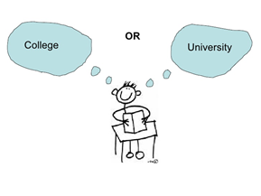
What is the difference?

Slide 19
University
College
Typically take 5 courses per semester, 3 hours of instruction of each class per week. Times of classes are scattered thoughout week/ September-April
An Undergraduate / Bachelors Degree takes 4 years to complete. Traditionally more training (ie., Masters, Ph.D) may be required afterwards to specialize.
Large class sizes (esp in first year)
Gaining a lot of knowledge on specific topics/subjects
$$
Typically has the same time layout as high school (8:30 AM-4pm, Monday-Friday/September-June)
Many programs are 1-2 years to obtain your diploma or Certificate
Smaller class sizes
Training for a Specific Career area
PRIVATE $$ VS PUBLIC $ (NBCC)

Slide 20
Are You Planning on Attending a Post-Secondary Institution?
Admission requirements are not the same as Graduation Requirements
Grade 11 and 12 grades are used by post-secondary institutions for acceptance (regardless in which semester taken). They will see this on your transcript when you submit your application.

Slide 21
Many Options for your Next Step
Workplace
Apprenticeship
Military
College
University

Slide 22
Apprenticeship
You can register as a pre-apprentice while in high school taking trades courses
01
High School Diploma needed to be part of Apprenticeship Program
02
Link to Interprovincial Red Seal Occupations
03
EARN WHILE YOU
LEARN

Slide 23
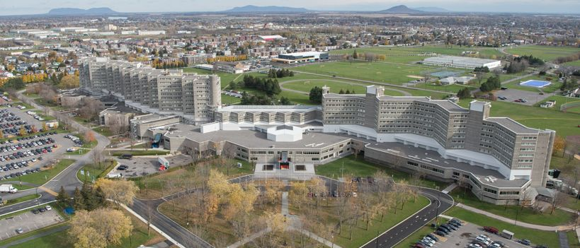
Military: 2 Routes to Join
Non-Commissioned Member (NCM)
High School Graduation and Aptitude Testing
Officer Training – University Entrance Requirements
Canadian Military Colleges (CMCs) — the Royal Military College of Canada (RMC) in Kingston, Ontario, and Royal Military College Saint-Jean (RMC Saint-Jean) in Saint-Jean-sur-Richelieu, Quebec
Joining the Forces (Link with Qualifications for both Routes)

Slide 24
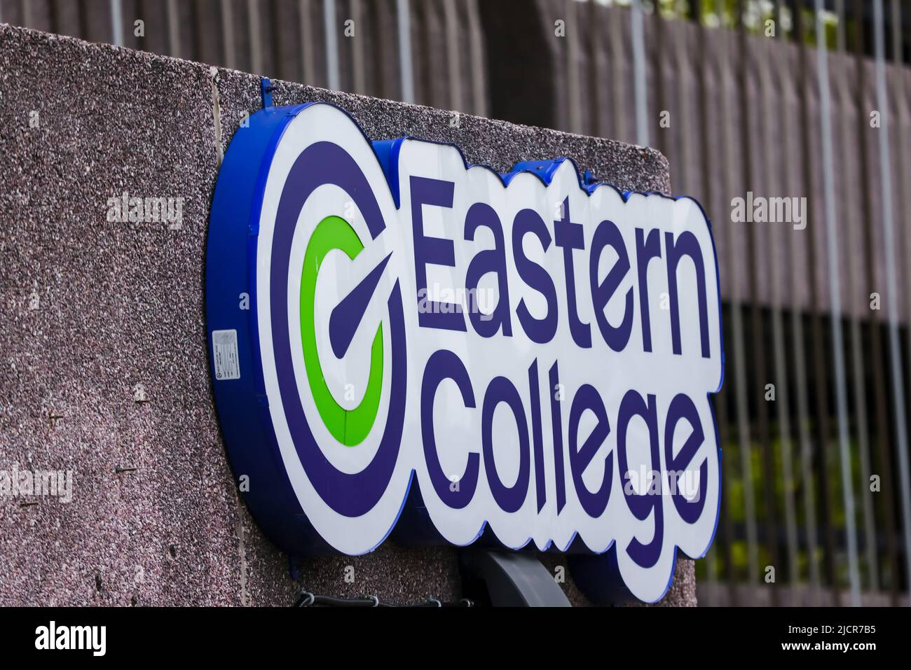
College
College/NBCC Programs
Many programs accept Level 3 courses
Some programs may require specific courses

Slide 25
NBCC Requirements
RESPIRATORY THERAPY
High School Diploma
Foundations of Math 110
Pre-Calculus 110
3 Sciences from: Biology 112 or 122, Chemistry 112 or 122, Physics 112 or 122
ELECTRICAL: CONSTRUCTION
High School Diploma al: CONSTRUCTION

Slide 26
University
Admission requires specific Level 2 courses, as well as certain marks
Each University has their own requirements: NEVER ASSUME, Check each university that you are considering. If their website is not clear, contact their school to see which electives they accept

Slide 27
Compare Graduation To University Admission Requirements
High School Graduation
English 111/112/113
English 121/122/123
Math 11 (Foundations 11 or Financial & Workplace Math 110)
Science 11/12
Modern History 111/112/113
Fine Arts/Life Role (specific list)
10 Electives
(5 Grade 12 courses)
Bachelor of Science - UNB
English 111/112
English 121/122
Foundations in Math 110
Pre-Calculus 110
Pre-Calculus 12A
Pre-Calculus 12B
Chemistry 112 & 122
Physics 112 & 122 OR Biology 12
Modern Hist. 111/112
Fine Arts/Life Role
Electives from Approved List
Minimum admission average 75%

Slide 28
Compare Graduation To University Admission Requirements
High School Graduation
English 111/112/113
English 121/122/123
Math 11 (Foundations 110 or Financial & Workplace Math 110
Science 11/12
Modern History 111/112/113
Fine Arts/Life Role
10 Electives
(5 Grade 12 courses)
BA (UNB/STU)
English 111/112
English 121/122
Math 11
Science 11/12
Modern History 111/112
Fine Arts/Life Role
4 - Grade 12 university
admissible courses
Electives
Min. admission average 65% UNB/ 70% STU

Slide 29
What’s Next?
More information (videos to reference) will be given during period 4 on Thursday, February 29th. You will receive your Course Selection Guide (put your name on it as it is your only copy). If you lose your copy a digital copy will be available on FHS Website.
Come up with a list of your 10 courses plus 2 Alternates
You will input your selections into PowerSchool by Tuesday, March 26th
Be sure to pass in your Expressions of Interests (if choosing any courses that require one) by the due date.
On Wednesday, March 13th there will be a Presentation for Parents of Grade 11 students in the TMT at 6:45pm.

